Slide 1
TB Grand Rounds
World TB Day
Jennifer Chevinsky, MD MPH FACPM DipABLM, Deputy Public Health Officer
Barbara Cole, RN, PHN, MSN, Director, Disease Control
Riverside University Health System Public Health
March 28, 2024

Slide 2
DISCLOSURE
The Riverside University Health System-Public Health, Riverside University Health System-Medical Center, RUHS-Medical Center CME, faculty, planners, speakers, CME Committee, and others in control of content (either individually or as a group) have no relevant financial relationships with ineligible companies.
There is no commercial support for this CME activity.
An ineligible company is any entity whose primary business is producing, marketing, selling, re-selling, or distributing healthcare products used by or on patients.

Slide 3
WELCOME & OVERVIEW
World TB Day Observance – March 24, 2024
Agenda
TB Trends
Evolving Landscape of TB Management
Managing individual patient care while adhering to public health laws
TB discharge approval process
Discussion and Q&A
CME Credit

Slide 4
TB Data and Trends

Slide 5
Global & US Data and trends
Global TB Infections: Estimated 25% of world population
Global TB Deaths (2022): 1.3 million
US TB Cases: 8,331 reported in 2022
US LTBI: Up to 13 million
Progression to Active TB: 5-10% without treatment
MDR-TB Cases in US (2022):
11 U.S.-born
77 non-U.S.–born
Notes:
Sure, here are the sources for each point:
US TB Cases: In 2022, there were 8,331 reported TB cases in the United States¹²³.
US M. tuberculosis Infections: The CDC estimates that 10-15 million Americans are infected with M. tuberculosis, with up to 13 million living with latent TB infection³.
Progression to Active TB: Without intervention, it’s generally accepted that 5-10% of people infected with TB will develop TB disease⁴⁵⁶.
MDR-TB Cases in US (2022): In 2022, there were 11 cases of multi-drug resistant TB (MDR-TB) among U.S.-born persons and 77 cases among non-U.S.–born persons⁷⁸.
Global TB Infections: It’s estimated that about a quarter of the world’s population may be infected with TB⁹¹⁰¹¹¹².
Global TB Deaths (2022): The most recent data suggests that 1.3 million people died from TB globally in 2022⁹¹³¹⁴¹⁵¹⁶.
California TB Cases: The number of TB cases in California increased from 1,704 in 2020 to 1,848 in 2022¹⁷¹⁸³.

Slide 6
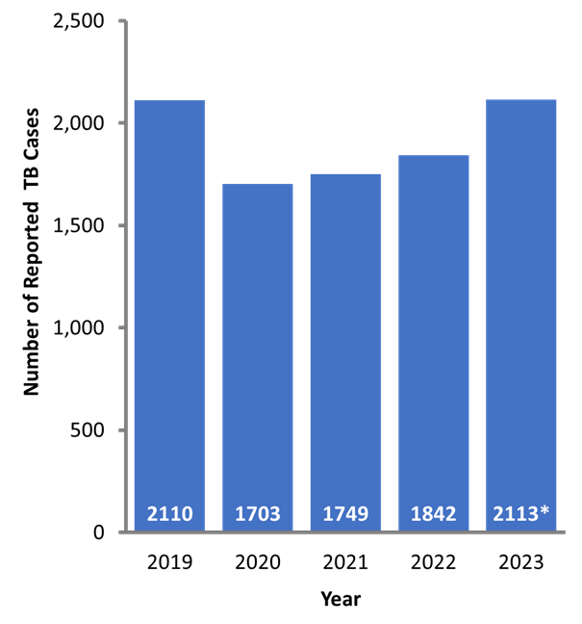
California Data and Trends
TB cases in CA: Increased by 15% in 2023, with a total increase of 24% since 2020
Mainly affects non-U.S. born (80% of cases).
Annual TB incidence (4.7/100k) nearly double national incidence (2.5)
TB mortality rate: Increased from 8.4% in 2010 to 13% in 2020
Over 200 deaths/year
Notes:
Substantial Increase in Tuberculosis in California: Recommendations for California Healthcare Providers

Slide 7
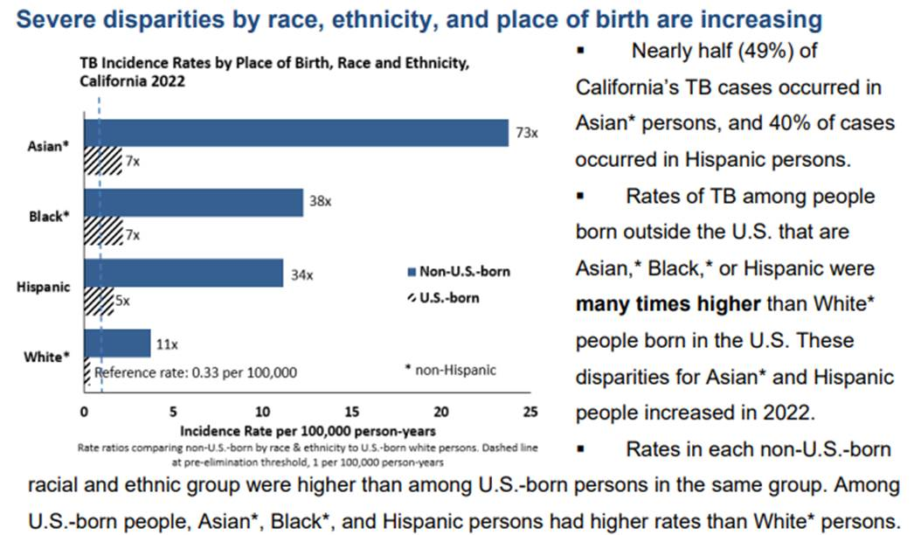
Disparities

Slide 9
EVOLVING LANDSCAPE OF TB MANAGEMENT

Slide 10
Updated USPSTF recommendations
Assessment of Higher Risk (USPSTF):
Foreign-born (Mexico, Philippines, India, Vietnam, China, etc.)
High-risk settings (homeless shelters, correctional facilities)
Immunosuppressed (HIV, immunosuppressive medications, organ recipients)
TB contacts (healthcare workers, high-risk congregate settings)

Slide 11
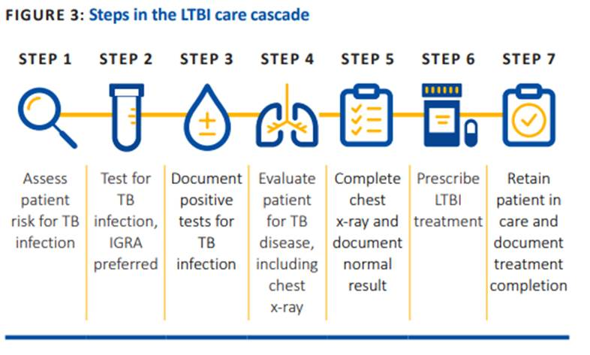

Slide 12
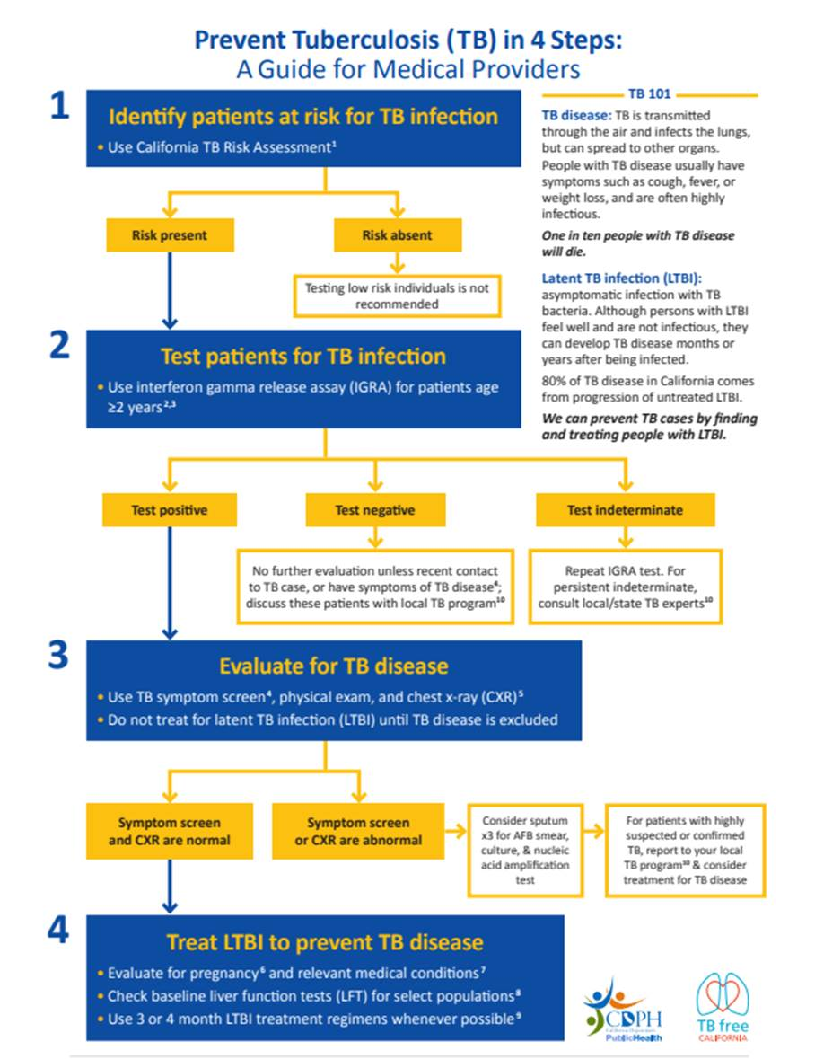

Slide 13
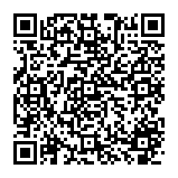
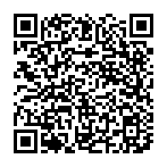
LTBI Risk Assessment
(Adult)
(Child)
Notes:
https://www.uspreventiveservicestaskforce.org/uspstf/recommendation/latent-tuberculosis-infection-screening
https://www.cdph.ca.gov/Programs/CID/DCDC/CDPH%20Document%20Library/TBCB-FAQ-on-USPSTF-Recommendation-on-LTBI.pdf
https://www.uspreventiveservicestaskforce.org/uspstf/recommendation/latent-tuberculosis-infection-screening
https://www.cdph.ca.gov/Programs/CID/DCDC/CDPH%20Document%20Library/TBCB-FAQ-on-USPSTF-Recommendation-on-LTBI.pdf

Slide 14
LTBI Testing options
Interferon-Gamma Release Assay (IGRA):
Measures CD4 T-cell response
Lab processing within 8-30 hours
Approved types: T-SPOT.TB, QuantiFERON-TB Gold In-Tube, QuantiFERON-Gold Plus
Tuberculin Skin Test (TST):
Administers protein derivative
Interpret response 48-72 hours later
IGRA vs. TST:
IGRAs recommended for high-risk populations.
More specificity in diagnosing LTBI.
Fewer false positives due to BCG vaccination or nontuberculous mycobacteria
Notes:
https://www.uspreventiveservicestaskforce.org/uspstf/recommendation/latent-tuberculosis-infection-screening
https://www.cdph.ca.gov/Programs/CID/DCDC/CDPH%20Document%20Library/TBCB-FAQ-on-USPSTF-Recommendation-on-LTBI.pdf

Slide 15
Notes:
https://www.uspreventiveservicestaskforce.org/uspstf/recommendation/latent-tuberculosis-infection-screening
https://www.cdph.ca.gov/Programs/CID/DCDC/CDPH%20Document%20Library/TBCB-FAQ-on-USPSTF-Recommendation-on-LTBI.pdf

Slide 16
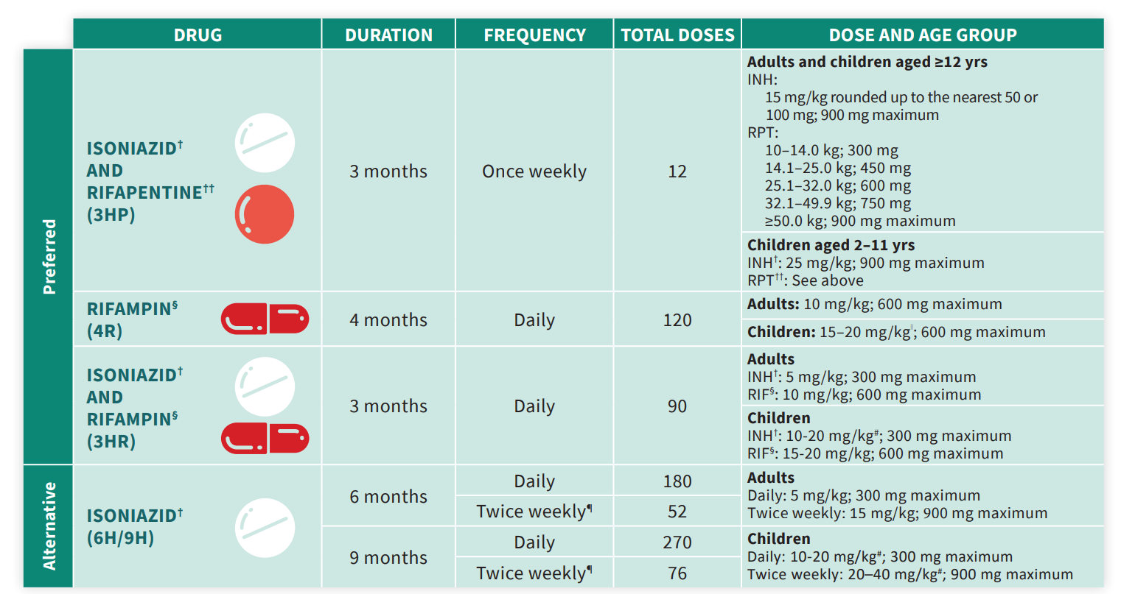

Slide 17
EVOLVING LANDSCAPE OF TB MANAGEMENT
Window/Primary Prophylaxis Using Isoniazid (INH)
Who Should Get It?
Children (particularly for children <5) with a negative TB test
Immunocompromised adults
Consideration to with recent contact to infectious TB cases, prioritizing household or prolonged exposure, and smear-positive cases
When to Stop?
After repeat of TB test (8-10 weeks after last exposure)
When to Transition to LTBI Treatment?
If repeat test is positive, then, transition to LTBI treatment, being mindful of resistance pattern for index case
Notes:
(1) Tips for Treating Latent Including Window TB Infection in Children .... https://www.heartlandntbc.org/wp-content/uploads/2021/12/tip_for_treating_LTBI_in_children.pdf.
(2) McSherry Window Prophylaxis - globaltb.njms.rutgers.edu. https://globaltb.njms.rutgers.edu/2018/PA%20TB%20Update/Handouts/McSherry_Window%20Prophylaxis.pdf.
(3) Window Period Prophylaxis for Children Exposed to Tuberculosis, Houston .... https://wwwnc.cdc.gov/eid/article/25/3/18-1596_article.
(4) Treatment Regimens for Latent TB Infection | TB | CDC. https://www.cdc.gov/tb/topic/treatment/ltbi.htm.
(5) Provider Fact Sheet - San Bernardino County, California. https://bing.com/search?q=who+should+get+window+prophylaxis+using+INH.
(6) Provider Fact Sheet - San Bernardino County, California. https://www.sbcounty.gov/uploads/DPH/Documents/2021/10/providerfactsheet-window-prophylaxis.pdf.
(7) RECOMMENDED DRUG REGIMENS FOR LTBI TREATMENT. https://globaltb.njms.rutgers.edu/downloads/products/ltbidrugcard.pdf.
(8) Window Period Prophylaxis for Children Exposed to Tuberculosis, Houston .... https://bing.com/search?q=when+to+stop+window+prophylaxis+using+INH.
(9) Guidelines for the Treatment of Latent Tuberculosis Infection.... https://www.cdc.gov/mmwr/volumes/69/rr/rr6901a1.htm.
(10) Isoniazid (INH) for Latent TB Infection (LTBI) Treatment. https://www.cdph.ca.gov/Programs/CID/DCDC/CDPH%20Document%20Library/TBCB-INH-for-LTBI-Fact-Sheet.pdf.
(11) Latent TB Infection Treatment FAQs for Clinicians. https://www.cdc.gov/tb/education/FAQforProviders.htm.

Slide 18
TB Diagnosis
TB Etiology & Symptoms:
Cause: Mycobacterium tuberculosis
Spread: Airborne
Infection: Can lead to Latent TB Infection (LTBI) or active TB
Clinical Signs: Productive cough (>2 weeks), chest pain, hemoptysis
Systemic Symptoms: Fever, chills, night sweats, loss of appetite, weight loss, fatigue
Diagnosis:
Medical history and physical exam
Skin test/TST: Negative doesn’t exclude LTBI/TB, BCG not contraindicated
QuantiFERON/blood assay test: Does not differentiate LTBI from Active
Does not cross-react with BCG
Chest radiograph, and Bacteriologic exam

Slide 19
TB Differential Diagnosis
TB often misdiagnosed as cancer due to:
False-positive PET/CT findings
Oncologic history
Elevated CA 125 or CA 19-9 levels
Index of Suspicion for TB
Clinical and epidemiological risk factors, Symptoms, Physical examination findings, Radiographic findings
Consider TB with the following symptoms:
Persistent unexplained fever for ≥2 weeks
Unremitting cough for ≥2 weeks
Unexplained documented weight loss >5% in the last 3 months despite adequate nutrition
Understandably, TB often initially misdiagnosed as pneumonia (including COVID-19 or flu) or lung cancer
Notes:
**Misdiagnosis of TB and Cancer**:
TB is often misdiagnosed as cancer due to false-positive positron emission tomography/computerized tomography (PET/CT) findings, an oncologic history, and elevated carbohydrate antigen 125 (CA 125) or carbohydrate antigen 19-9 (CA 19-9) levels². On the other hand, cancer is sometimes misdiagnosed as TB due to a history of TB, a positive tuberculin test, and a history of a rare cancer². Diseases most often initially misdiagnosed as TB include pneumonia and lung cancer[^10^].
**Index of Suspicion for TB**:
The index of suspicion for TB should be based on consideration of clinical and epidemiological risk factors, symptoms, physical examination findings (e.g., enlarged lymph nodes or other findings suggestive of possible extra-pulmonary involvement), and radiographic findings⁵. Strong clinical suspicion for TB is required in populations having constitutional symptoms defined as persistent unexplained fever documented for ≥2 weeks and/or unremitting cough for ≥2 weeks and/or unexplained documented loss of weight >5% in the last 3 months despite adequate nutrition⁷.
**Note**: Clinicians should have a high index of suspicion
Source:
(1) Lung Cancer vs Tuberculosis: Key Differences Explained. https://brio-medical.com/lung-cancer-vs-tuberculosis/.
(2) Diagnosing Latent TB Infection & TB Disease | TB | CDC. https://www.cdc.gov/tb/topic/testing/diagnosingltbi.htm.
(3) Frontiers | Cancer or Tuberculosis: A Comprehensive Review of the .... https://www.frontiersin.org/journals/oncology/articles/10.3389/fonc.2021.644150/full.
(4) Misdiagnosed pulmonary TB: Influencing factors and diagnostic chances .... https://erj.ersjournals.com/content/40/Suppl_56/P2720.
(5) Drug-Resistant Tuberculosis: A Survival Guide for Clinicians, 3rd edition. https://www.currytbcenter.ucsf.edu/sites/default/files/2022-05/tb_sg3_chap2_diagnosis.pdf.
(6) Clinical and Radiological Diagnosis of Tuberculosis. https://link.springer.com/chapter/10.1007/978-981-99-5624-1_2.

Slide 20
Recommendations for Active TB
Active TB Disease Diagnosis & Treatment:
Report: Suspected cases should be reported to RUHS-PH
Referrals: Expedite referrals for diagnostic procedures and to sub-specialists or the public health TB clinic
Tests: Obtain chest imaging, HIV test, and consider screening for diabetes and viral hepatitis for at-risk patients
Samples: Collect 3 sputum samples 8-24 hours apart for AFB smear, culture, and susceptibility testing
NAAT: Obtain NAAT for rapid detection within 24-48 hours
Treatment: Start TB treatment if TB disease is reasonably suspected or confirmed. Treat according to national TB guidelines.
Consultation: Discuss any alternate regimens with RUHS-PH.
Notes:
https://www.uspreventiveservicestaskforce.org/uspstf/recommendation/latent-tuberculosis-infection-screening
https://www.cdph.ca.gov/Programs/CID/DCDC/CDPH%20Document%20Library/TBCB-FAQ-on-USPSTF-Recommendation-on-LTBI.pdf

Slide 21
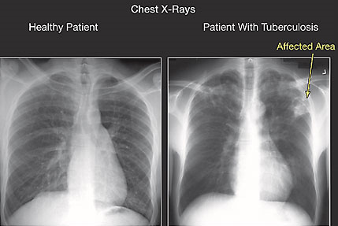
Radiographic findings
Chest Radiograph:
Typically observed in the apical and posterior segments of the upper lobe.
Can also appear in the superior segments of the lower lobe.
Potential to cause cavitary lesions.
CXR findings may vary, particularly in HIV patients.
These findings increase diagnostic probability but do not confirm TB.

Slide 22
Many types of mycobacterium
Legitimate Name | Runyon Group | Acceptable Common Name | Suggested Report Based on Use of Minimal Differential Test
M. tuberculosis |  | Human tubercle bacillus | M. tuberculosis
M. bovis |  | Bovine tubercle bacillus | M. bovis
M. avium | III | Avian tubercle bacillus | M. intracellulare M. avium complex
M. kansasii | I |  | M. kansasii (high) catalase (low) variety
M. marinum | I |  | M. marinum
M. scrofulaceum | II | Scrofula scotochromogen | M. scrofulaceum
M. gordonae** | II | Tap water scotochromogen | M. gordonae
M. szulgai | II |  | M. szulgai
M. flavescens | II |  | M. flavescens
M. intracellulare | III | Battey bacillus | M. intracellulare M. avium complex
M. xeonpi | III |  | M. xenopi
M. simiae (M. habana) | III |  | M. simiae or M. simiae M. habana complex
M. nonchromogenicum M. terrae | III III | Radish bacillus | M. terrae complex
M. triviale | III |  | M. triviale
M. gastri | III |  | M. gastri
M. fortuitum | IV |  | M. fortuitum or M. fortuitum complex
M. chelonei*** (N+) M. chelonei, subsp. M. abscessus | IV | (M. borstelense) (M. abscessus) | M. fortuitum complex
M. phlei M. smegmatis | IV IV |  | Group IV, not M. fortuitum
M. ulcerans |  |  | M. ulcerans
Rhodochrous group |  |  | Rhodochrous group
Mycobacterial Nomenclature
Not everything that is mycobacterium, is tuberculosis

Slide 23
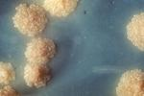
Microbiological testing
Bacteriologic Smear Exam:
Results in <24 hours
AFB presence indicates TB
Provides rough estimate of MTB burden and infectivity
Negative AFB smear doesn’t rule out TB
Cepheid GeneXpert system:
Detects MTB DNA and rifampicin resistance
Cultures:
Confirmatory TB test
Culture all specimens, even negative smears
Possible dual infection (TB & MAC)
TB Culture: Distinctive clusters of colorless Mycobacterium tuberculosis form in this culture.

Slide 24
Other testing and treatment considerations
HIV Testing for TB Patients:
Assess TB patients for HIV
Co-infection requires expert care and coordinated treatment
Treatment of Active TB Patients:
Aim for safe, effective, and quick treatment
Use multi-drug regimens
Don’t add single drug to failing regimen
Ensure adherence (DOT provided by Public Health)
Start with 4-drug regimen (RIF, INH, PZA, EMB), adjust, as necessary.
MDR/XDR-TB extended regimen, consult RUHS-PH

Slide 25
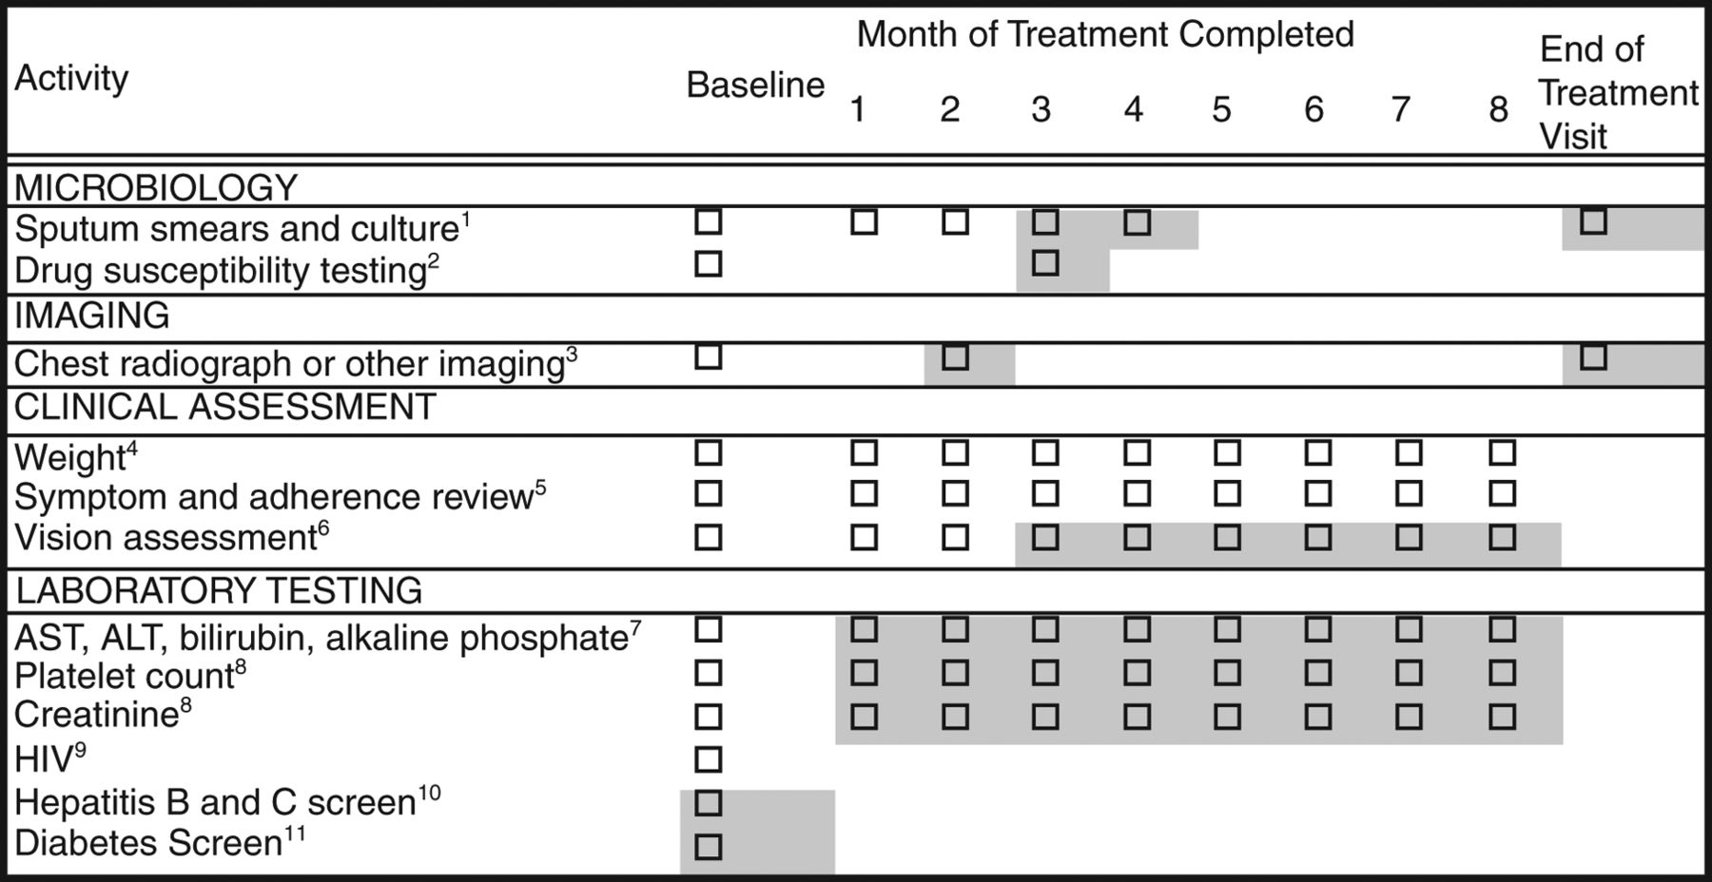
Treatment Monitoring
Notes:
Baseline and follow-up evaluations for patients treated with first-line tuberculosis medications. Shading around boxes indicates activities that are optional or contingent on other information.

Slide 26
MDR and XDR TB
MDR TB: Resistant to isoniazid and rifampin
1-2% of CA TB patients have MDR; Riverside County has had 4 in the past 2 years
XDR TB: Resistant to isoniazid, rifampin, a fluoroquinolone, and a second-line injectable (or bedaquiline or linezolid)
Introduction of new shorter-course regimen for MDR and XDR TB (BPaL-M)
Reduces MDR-TB treatment from 18-24 months to 6-9 months. bedaquiline, pretomanid, linezolid, and moxifloxacin (BPaL-M)

Slide 27
TB MeNINGITIS
Three cases in Riverside County in past 2 years
TB Meningitis - Step 1: Diagnosis
Indications for CNS evaluation: signs/symptoms, miliary/disseminated disease, immunosuppressed host, age ≤ 1-year-old
Components of CNS TB evaluation: lumbar puncture, optimize bacteriologic yield for DST’s, imaging (head CT, brain MRI, CTA/MRA).
Step 2: Management
Molecular and phenotypic DST’s: use MTB/RIF (GeneXpert) PCR, consult RUHS-PH
Adjunctive immunomodulation: glucocorticoids recommended for all patients, individualized steroid tapers
Serial imaging: Document radiographic progress. Repeat MRI after 2-3 months.

Slide 28
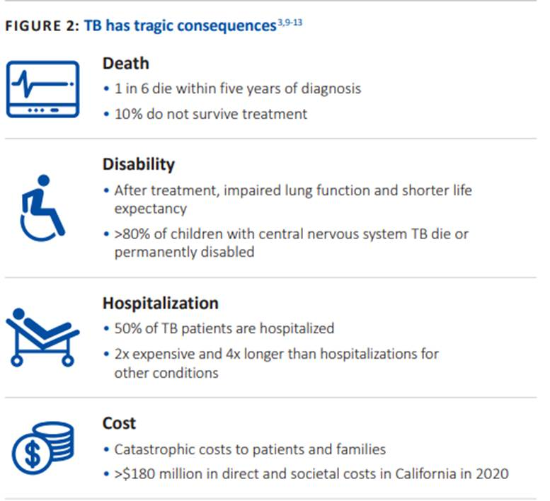
Consequences of TB

Slide 29
MANAGING INDIVIDUAL PATIENT CARE WHILE ADHERING TO PUBLIC HEALTH LAWS
Barbara Cole, RN, MSN, PHN

Slide 30
Patient Centered Care vs. Population Health
Important to meet the medical and psychosocial needs of the individual patient, while ensuring the community is not put at risk from a person who is contagious (e.g., discharge of a TB patient who has not been cleared by Public Health.

Slide 31
Mandated Public Health Programs
General Communicable Diseases
Immunizations
Sexually Transmitted Diseases
Tuberculosis

Slide 32
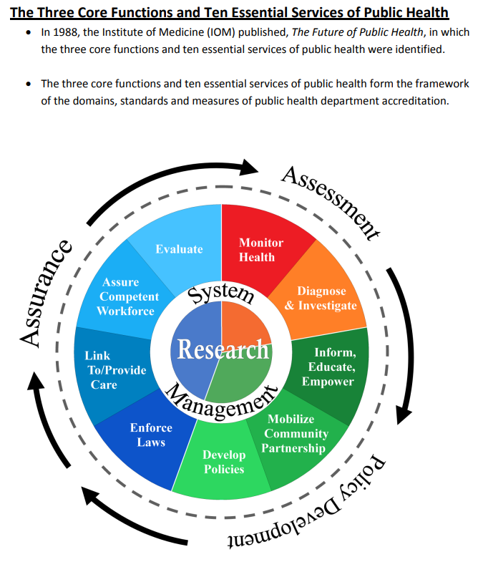

Slide 33
Public Health Core Functions
Assessment -Monitor Health- Oversight Responsibility
Diagnose & Investigate TB and other diseases
Evaluate individuals exposed to TB and other communicable diseases
Policy Development
Develop criteria for implementing and lifting isolation requirements
Provide updated treatment recommendations
Assurance
Link to/provide care
Enforce laws

Slide 34
Hospital Exposures / Infection Prevention
It is important to maintain a high index of suspicion for TB in patients with cavitary lesions and s/s consistent with TB
Negative pressure isolation is recommended until TB is ruled out or has 3 consecutive negative AFB smears from respiratory specimens and has been on appropriate treatment
Smear negative, culture positive patients not on treatment can still transmit to disease to others
There have been five TB exposures in Riverside County hospitals in the past six months

Slide 35
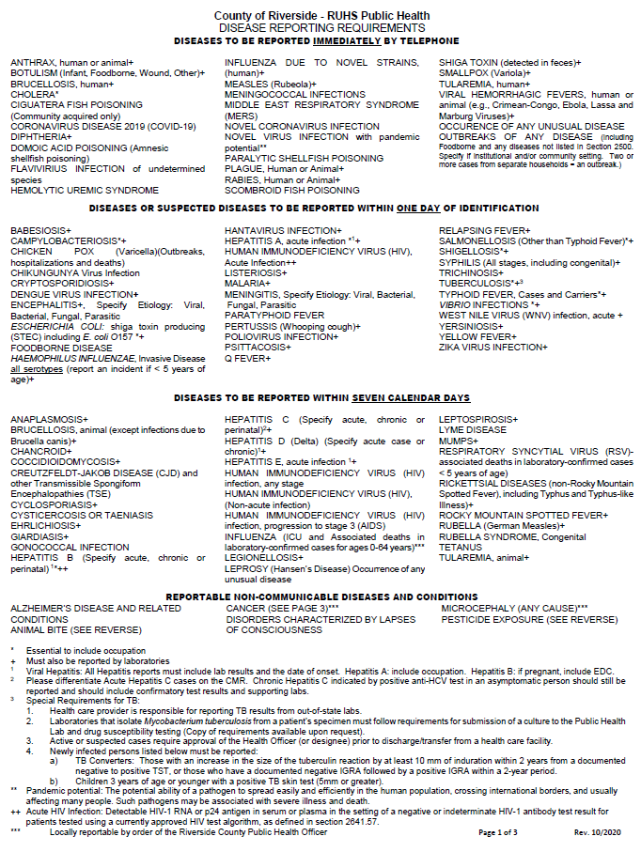
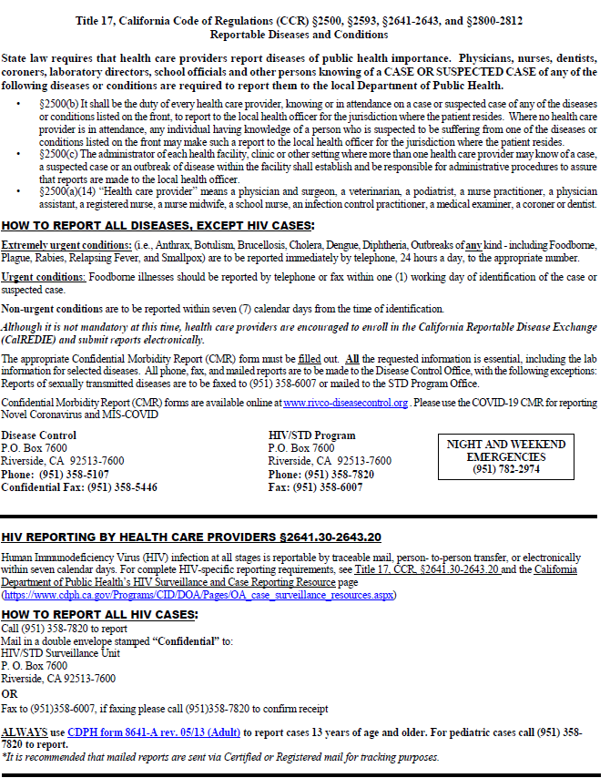
Disease Reporting Requirements

Slide 36
Potential Barriers to Discharge Approval
Smear positive patient going to a high-risk setting (e.g., SNF; home with a young child)
Smear negative patient with cultures pending
not on treatment-requires hemodialysis
Patient being discharged/transferred to another jurisdiction-requires cross clearance

Slide 37
TB DISCHARGE
APPROVAL PROCESS

Slide 38
Legal Requirement for Obtaining Discharge Approval
Law in effect since 1994
Health and Safety Code Section 12131 – Continuity of Care
Requires written treatment plan
Health and Safety Code Section 121361-Discharge of patient with active or suspect active TB
Require Public Health response withing 24 hours
Patient requires transfer for a higher level of care
Sending LHD can approve if coordination with receiving jurisdiction would jeopardize the patient’s health

Slide 39
Situations Requiring Discharge Approval
Any person who has been placed in TB isolation, even if one or more AFB smears are negative
Any person in whom a smear or preliminary culture results from any body fluid or tissue is positive for acid-fast bacilli
Any person with pathologic findings consistent with active TB, unless other clinical evidence makes a TB diagnosis unlikely

Slide 40
Situations Requiring Discharge Approval (cont.)
Any person with clinical radiographic, or laboratory evidence consistent with active TB:
Even if the diagnostic evaluation is incomplete or culture results are pending;
In whom the level of clinical suspicion of active TB is high enough to warrant the initiation of anti-tuberculous therapy;
whether or not such therapy has actually been started
Any person who has started on anti-tuberculous therapy for clinical suspicion of active TB

Slide 41
Procedure for Obtaining Discharge Approval of TB Suspect and Cases
Complete a Confidential Discharge Plan and Approval form, ensuring all information requested is provided
Clinical information to be completed and signed by physician
Fax completed form, H&P, MD progress notes, and chest x-ray/CT reports to Disease Control at (951) 358-7922

Slide 42
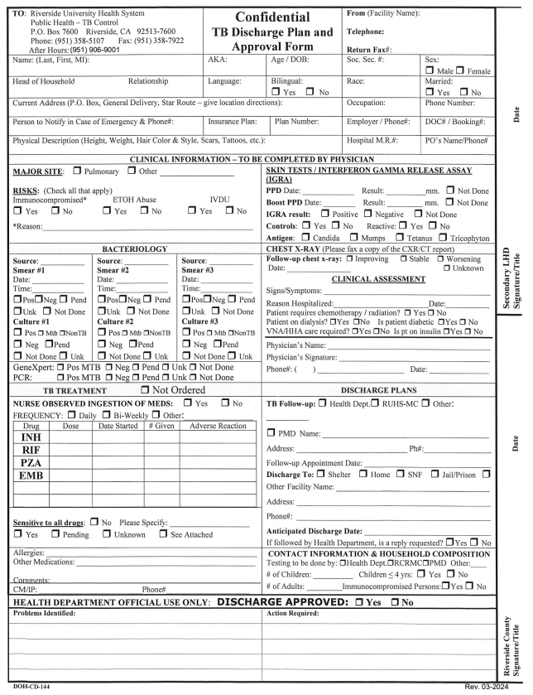

Slide 43
Procedure for Obtaining Discharge Approval of TB Suspect and Cases (cont.)
Ideally, the form should be submitted to TB Control one (1) or two (2) days prior to the anticipated discharge
If discharge approval is needed after hours and the
request for discharge approval has already been submitted contact Barbara Cole at: (951) 906-9001.

Slide 44
Criteria for Discharge of TB Patients
Absence of high-risk individuals in the home
Patient has been started on appropriate therapy and is tolerating medication
Patient has had three (3) specimens collected for AFB smear and culture. Sputum specimens may be collected > 8 hours apart. At least one (1) specimen must be early AM, a bronco-alveolar lavage (BAL), or collected post bronchoscopy
If patient is still smear positive, must agree to and sign home isolation agreement
The patient is clinically stable

Slide 45
Criteria for Discharge of TB Patients (Continued)
High risk individuals in the home or going to high-risk environment
Patient has been on appropriate therapy for at least two (2) weeks
Patient has three (3) consecutive respiratory specimens, including at least one (1) early AM or induced sputum, or BAL, collected at least eight (8) hours apart, that are AFB smear negative
Patient is clinically stable

Slide 46
Criteria for Discharge of TB Patients (cont.)
The physician has established a plan for ongoing follow-up and treatment after discharge
Department of Public Health has reviewed and approved the discharge

Slide 47
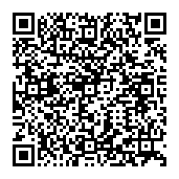
DISCUSSION; Q&A
PROVIDER RESOURCES
CDC ATS Hospital Care
Discharge approval cards
LTBI primary care

Slide 48
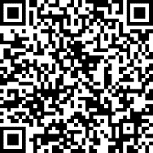
Thank you for Attending
For certificate request please scan to complete the survey.
https://www.surveymonkey.com/r/JP24-MAR28
Questions, reach us at:
(951) 358-5107

Slide 49
Reminders:
Consider TB in differential diagnosis for respiratory illnesses, especially in patients with TB risk factors or prolonged symptoms
Test and treat for LTBI in at-risk patients to prevent active TB disease
Suspected and confirmed TB cases must be reported to local public health departments within 1 day of identification

